Slide 1
Welcome Young Europeans
www.consolacionbenicarlo.org

Slide 2
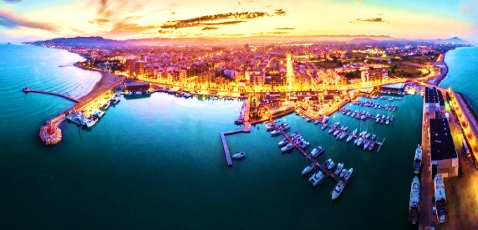
OUR TOWN: BENICARLÓ

Slide 3
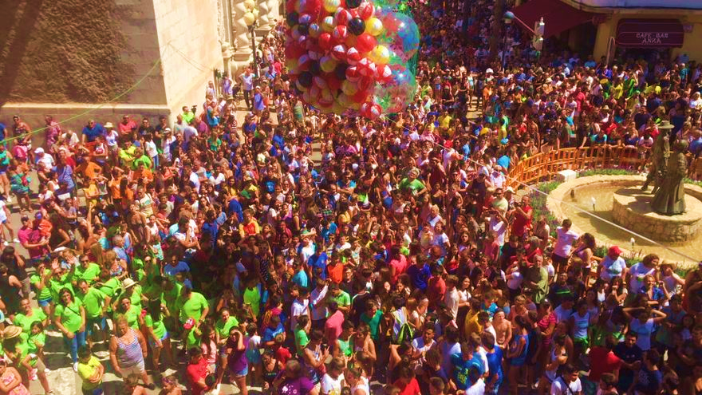
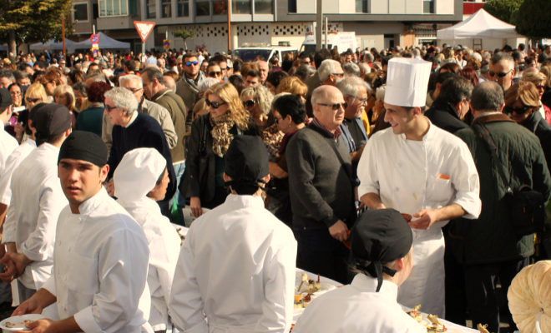
TOTAL POPULATION: 28.380

Slide 4
AGE RANGE IN BENICARLÓ

Slide 5
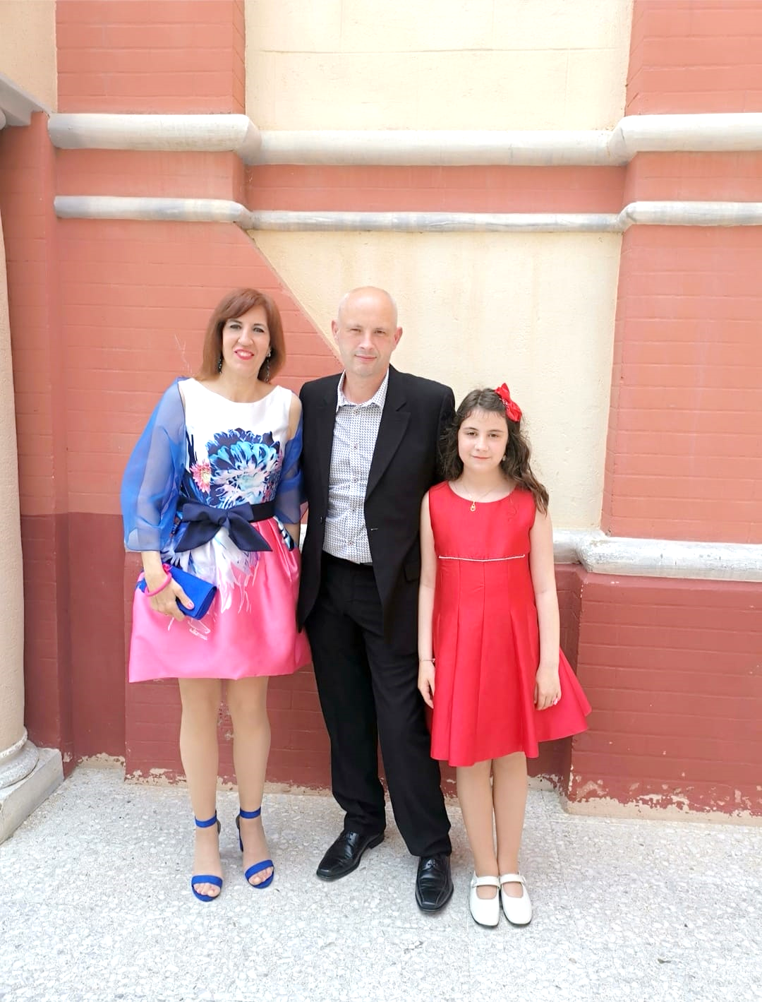
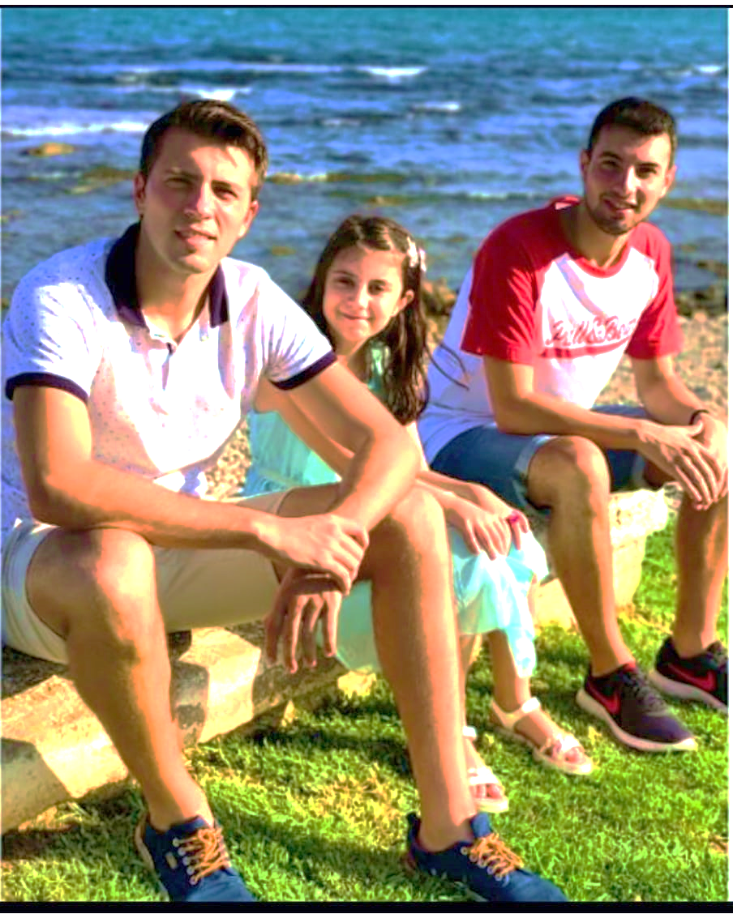
OUR PEOPLE
Edited by: M.Carme M.P.

Slide 6
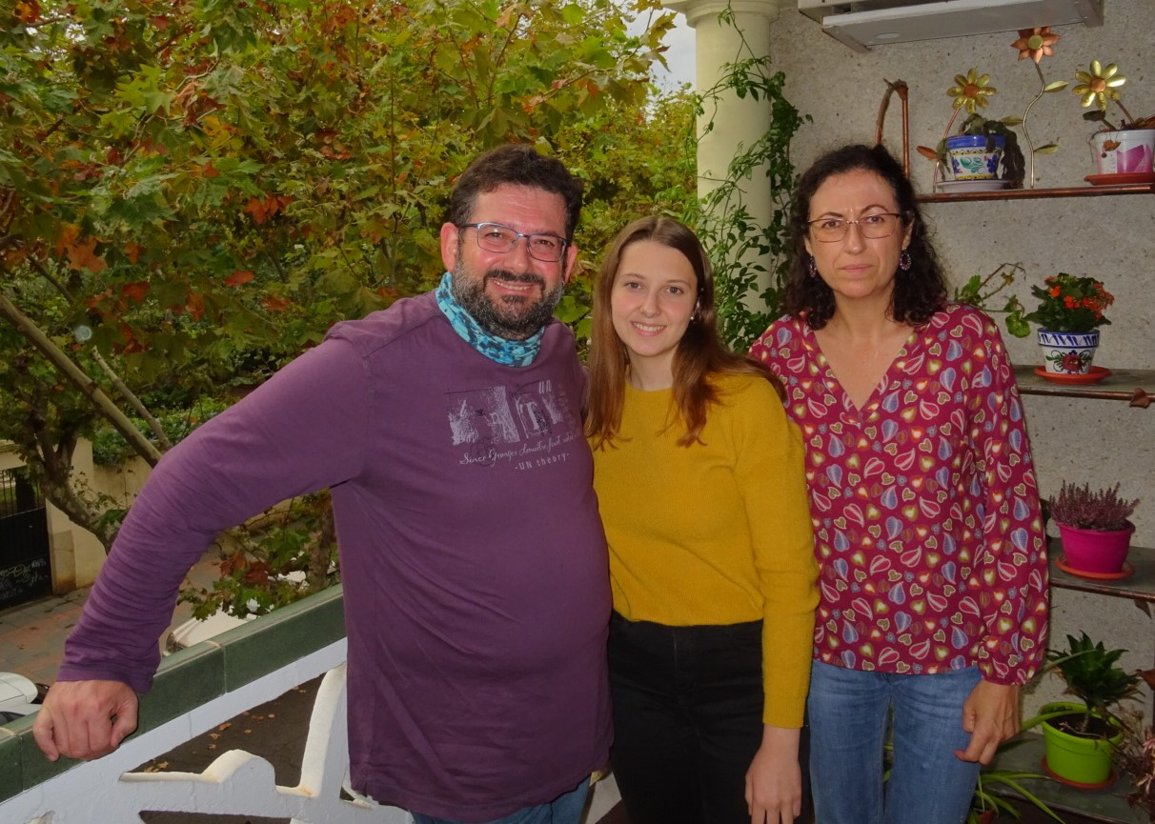
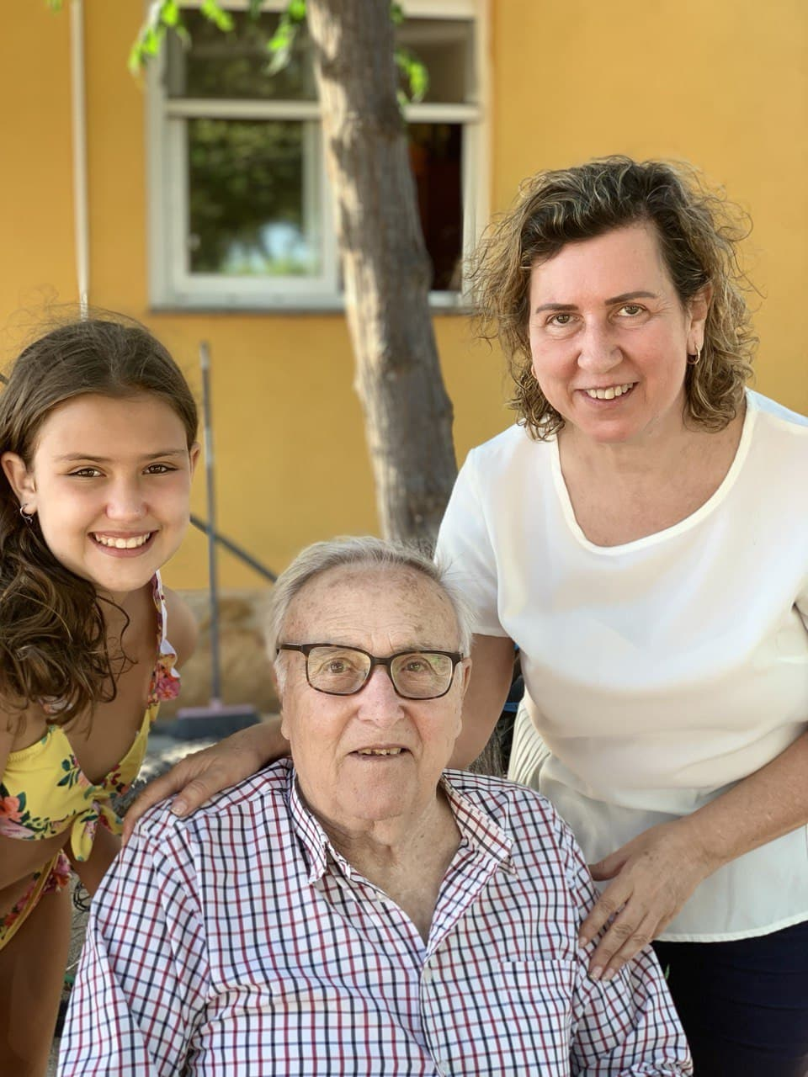
OUR PEOPLE
Edited by: Irene S.A.

Slide 7
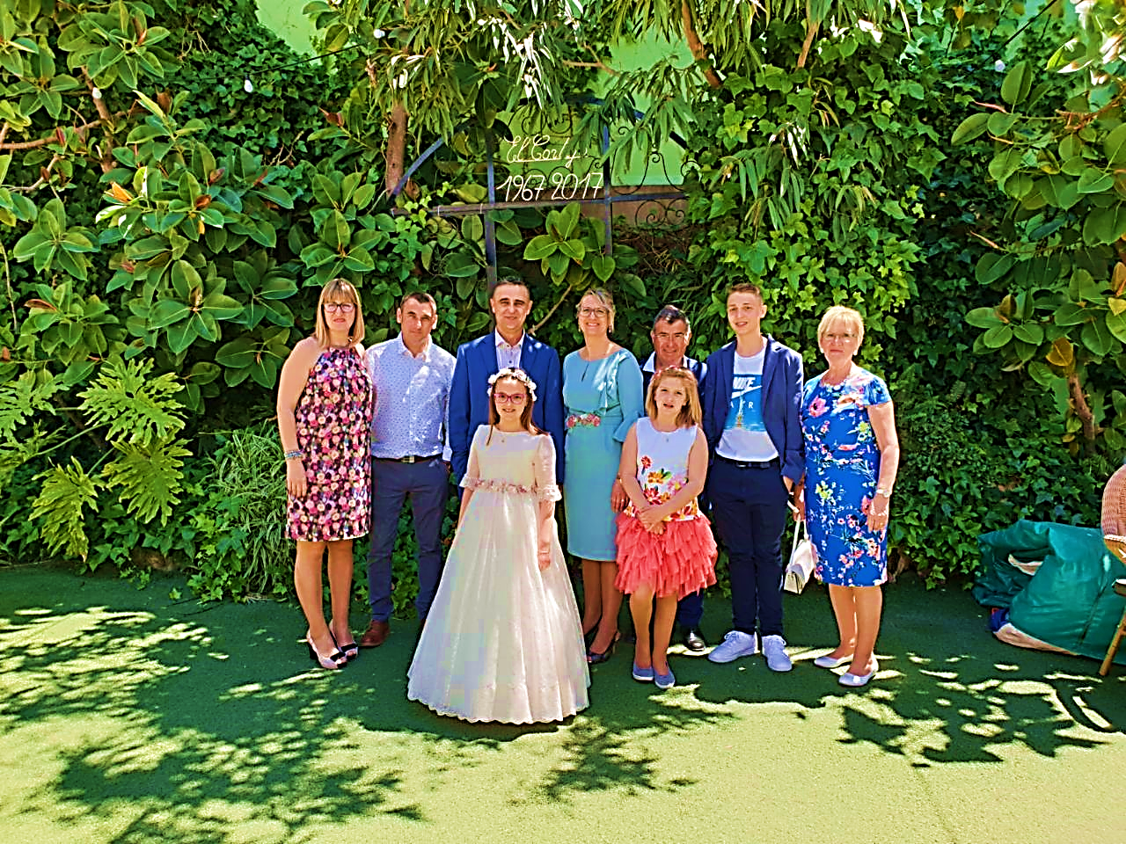
OUR PEOPLE
Edited by: Lara U.P.

Slide 8
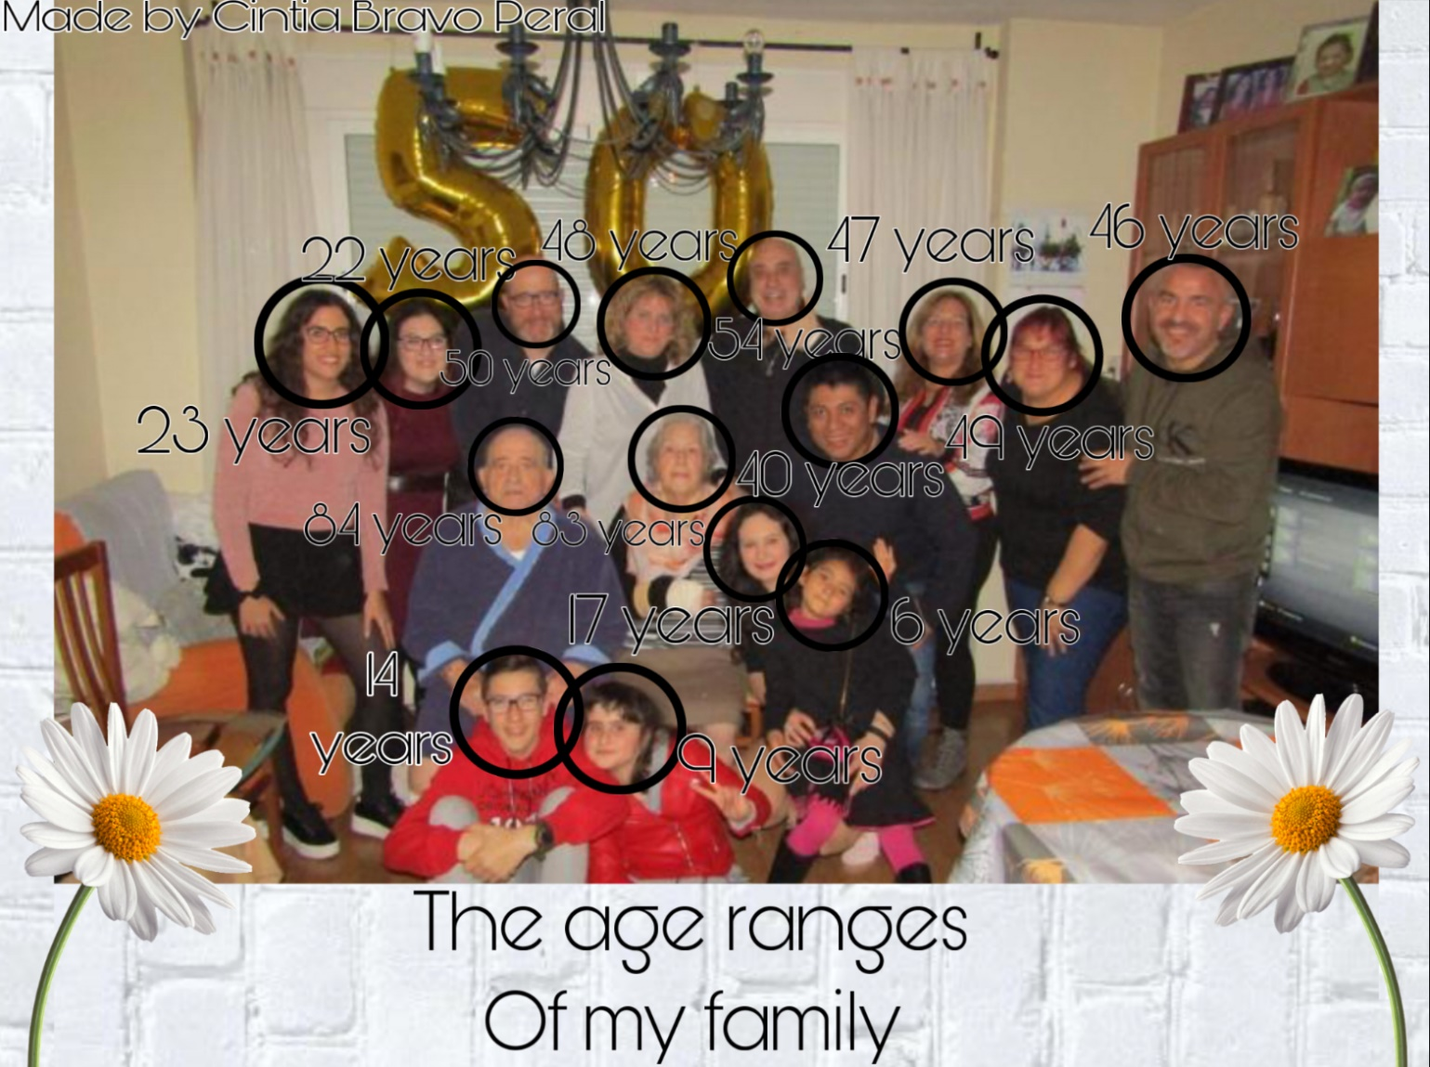
OUR PEOPLE
Edited by: M.Cintia B.P.

Slide 9
Graphics and photo edition 6ºB

Slide 10
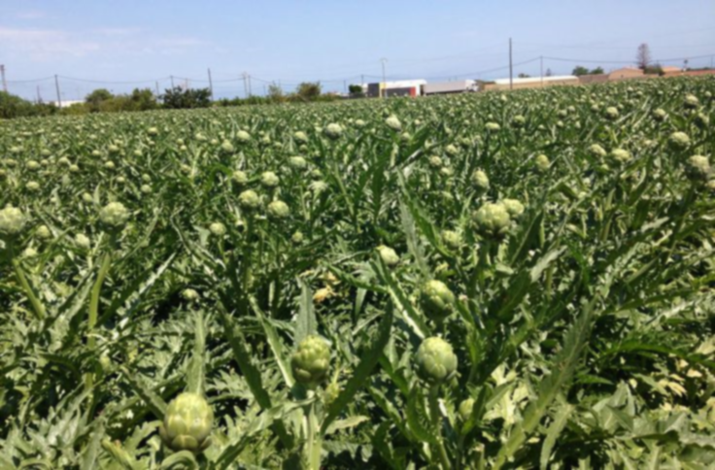
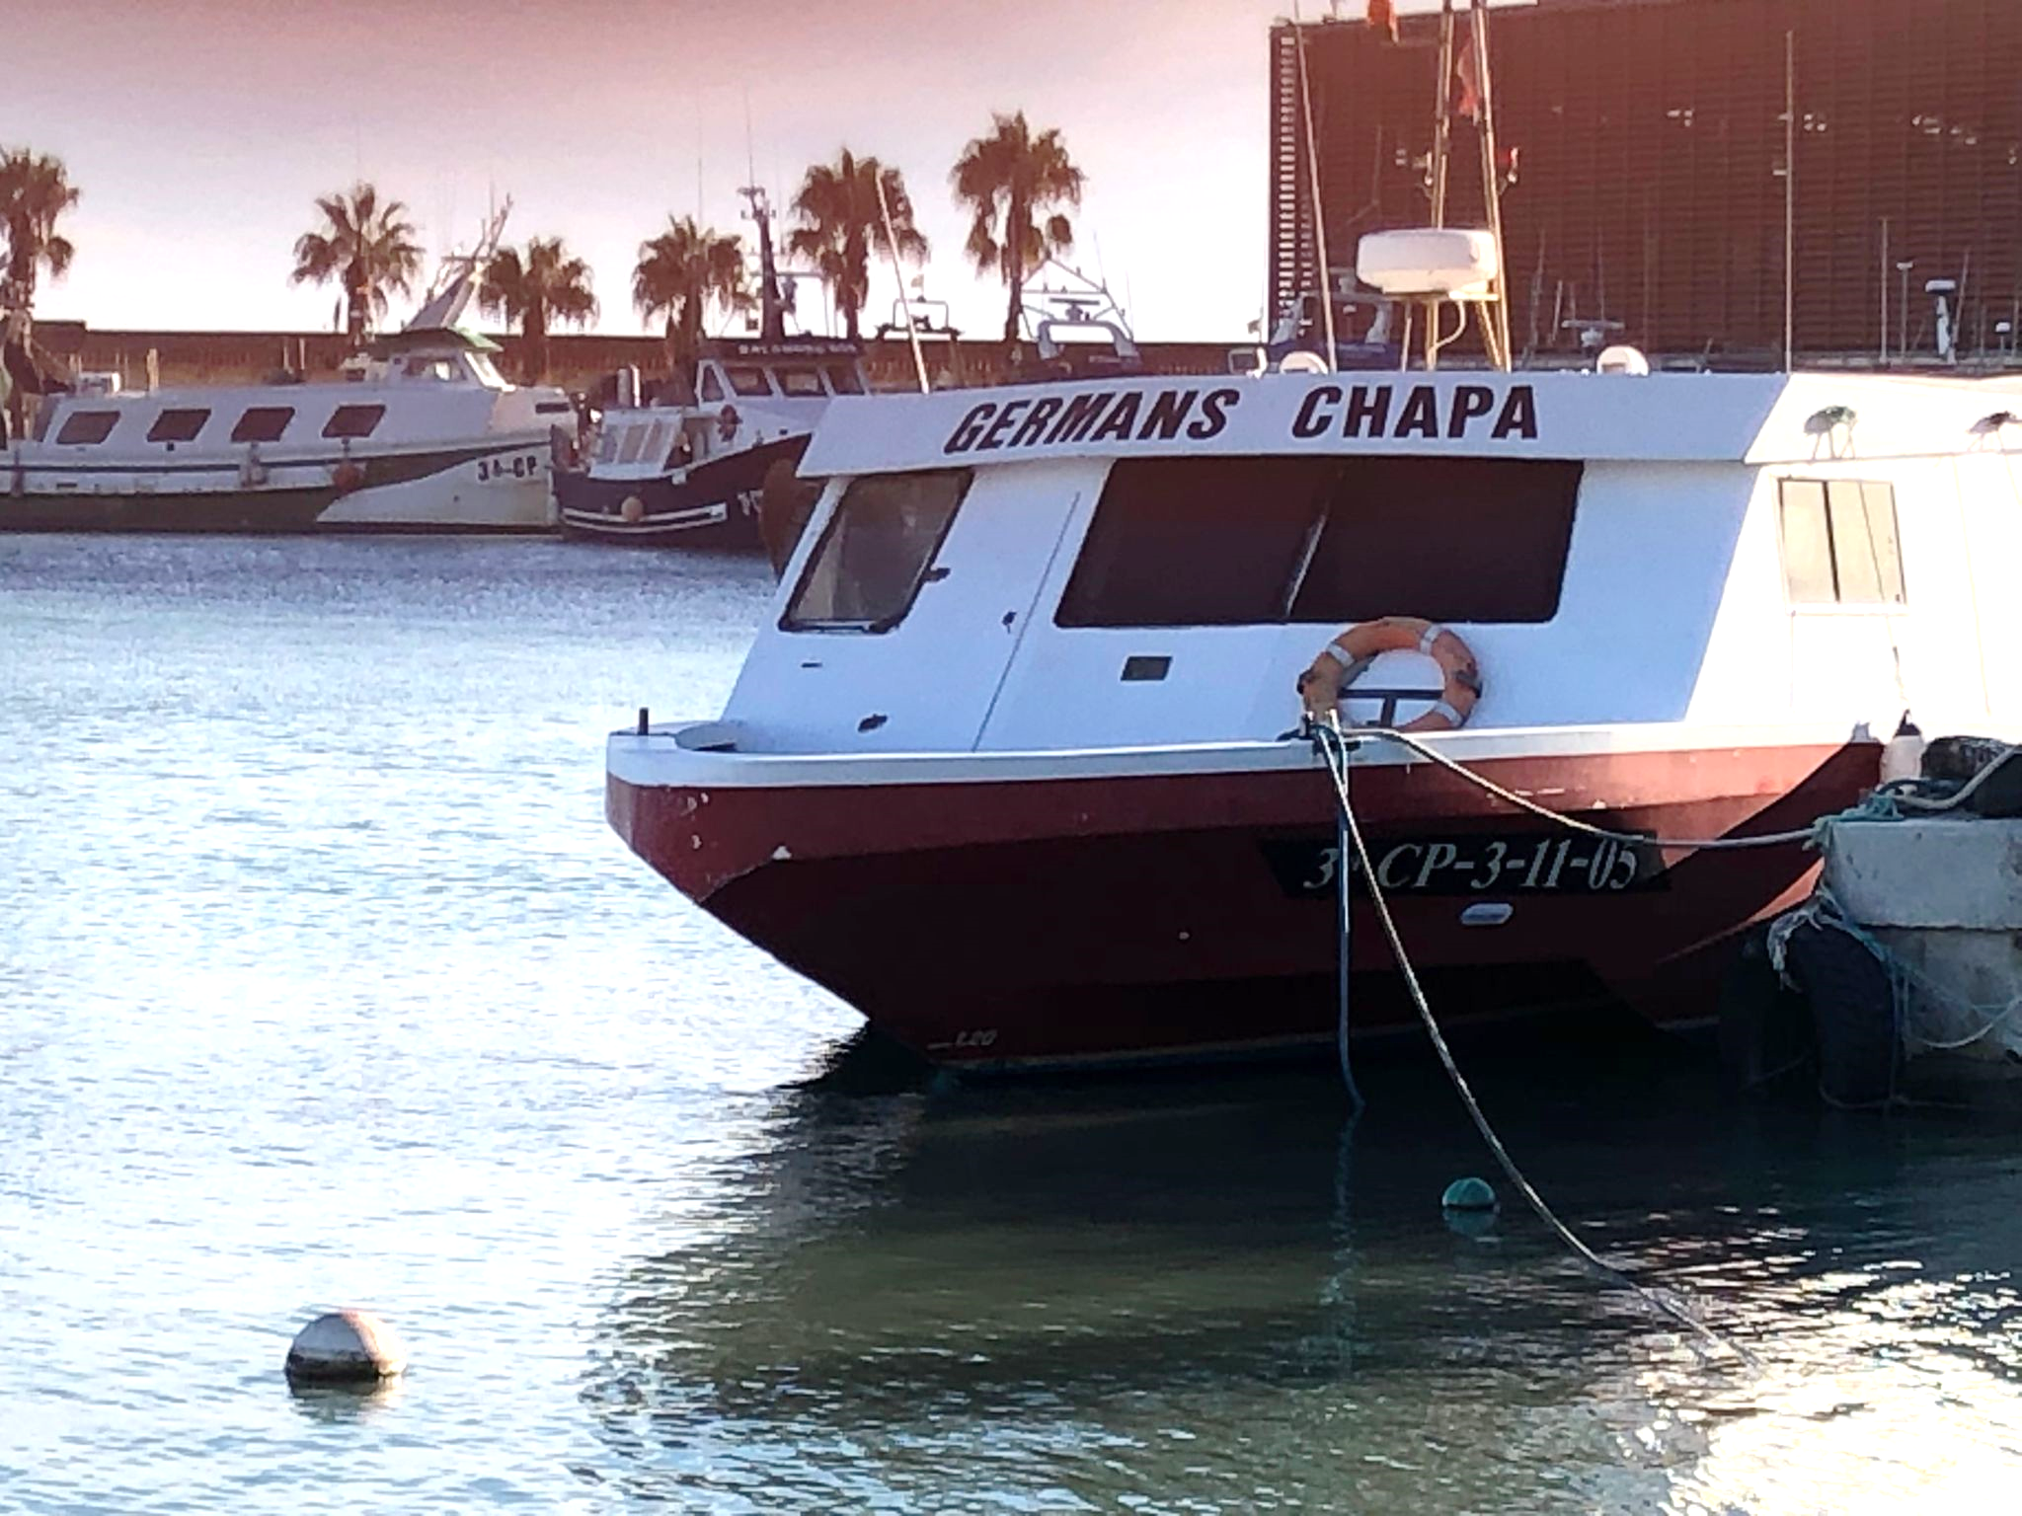
AGRICULTURE
FISHING

Slide 11
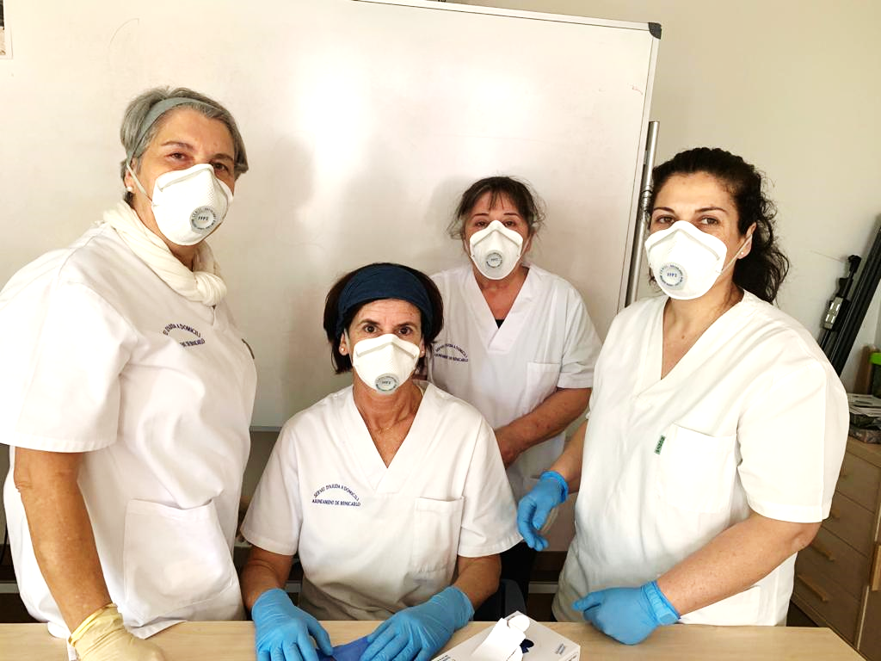
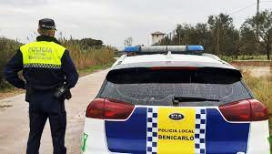
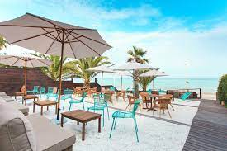
SERVICES

Slide 12
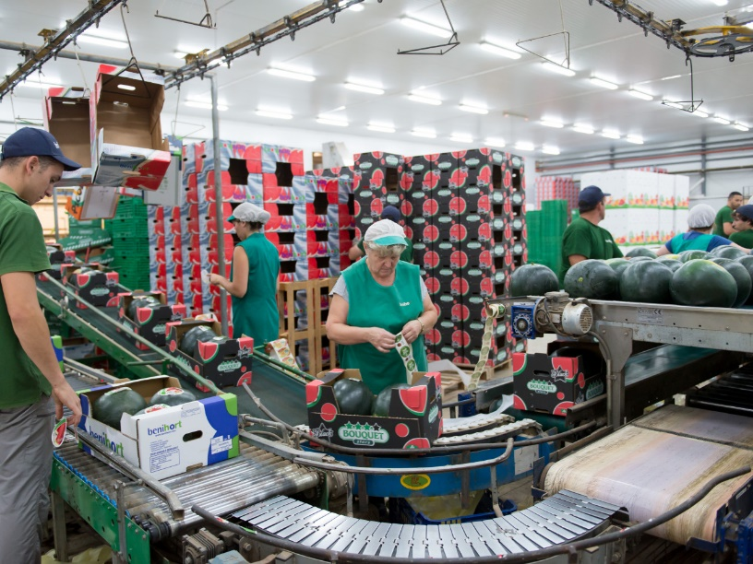
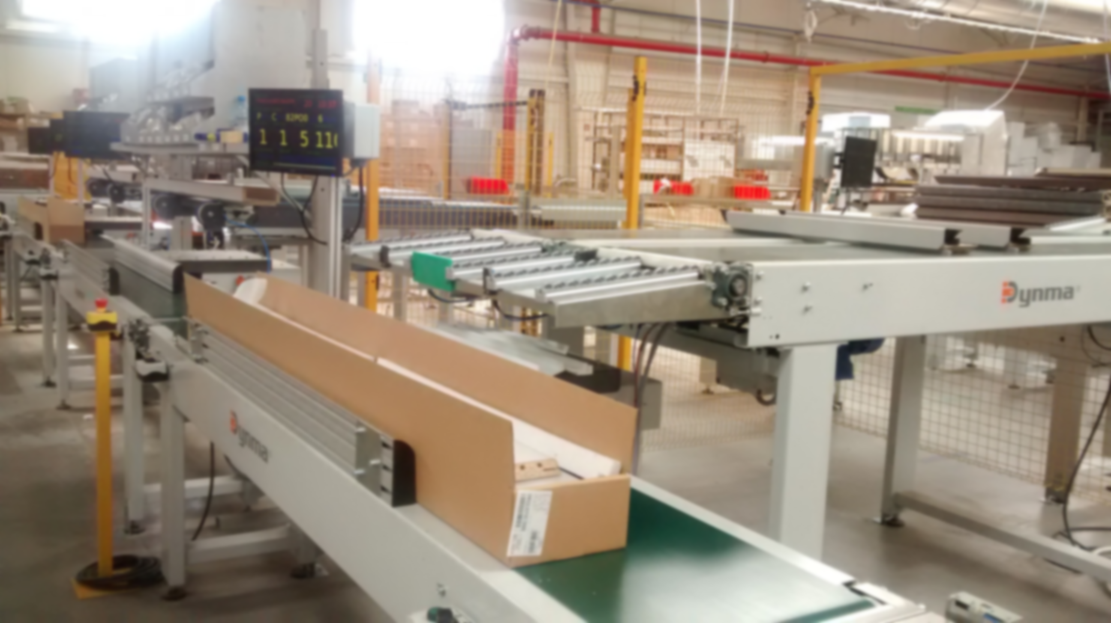
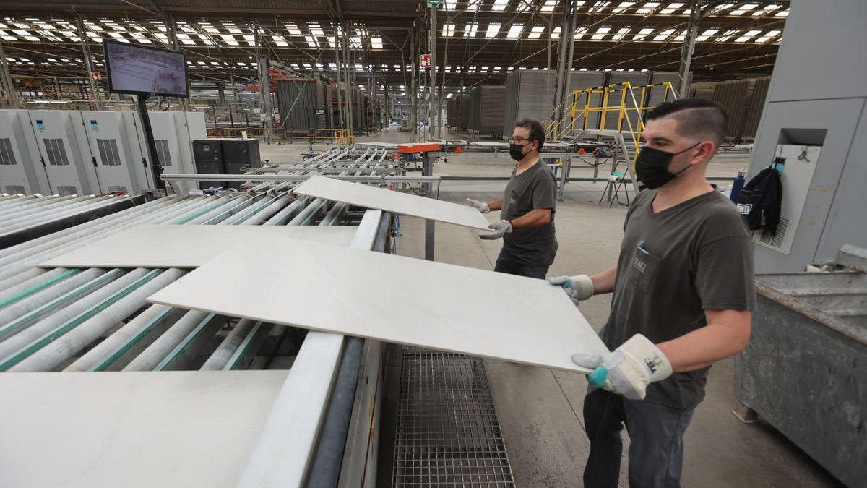
INDUSTRY

Slide 13
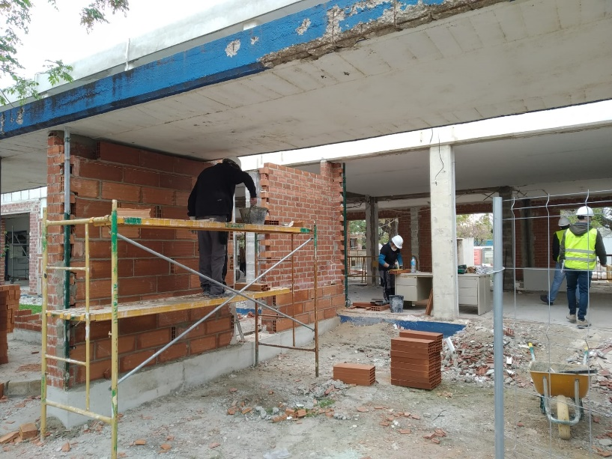
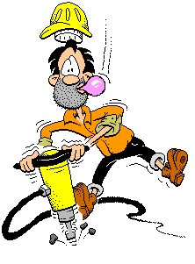
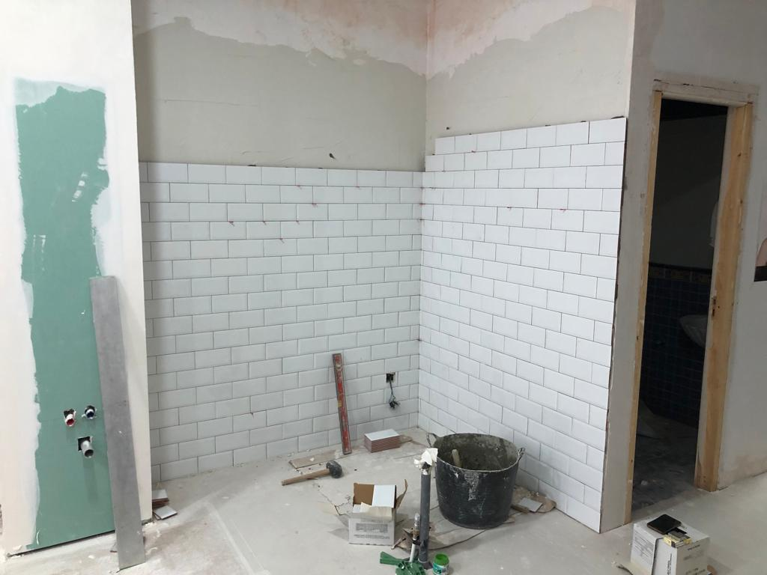
CONSTRUCTION

Slide 15
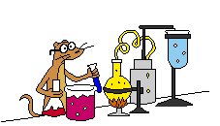
SCHOOL SUBJECTS
MATHS
SCIENCE

Slide 16
THREE DIFFERENT LANGUAGES
VALENCIAN
SPANISH
ENGLISH

Slide 17
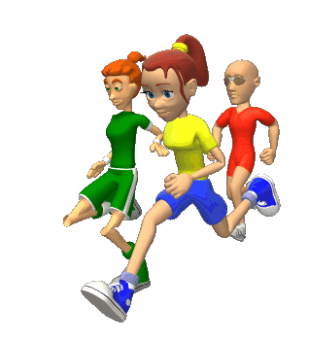
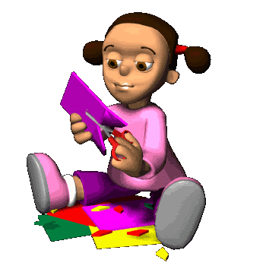
MUSIC
ART & CRAFTS
PHYSICAL
EDUCATION

Slide 19
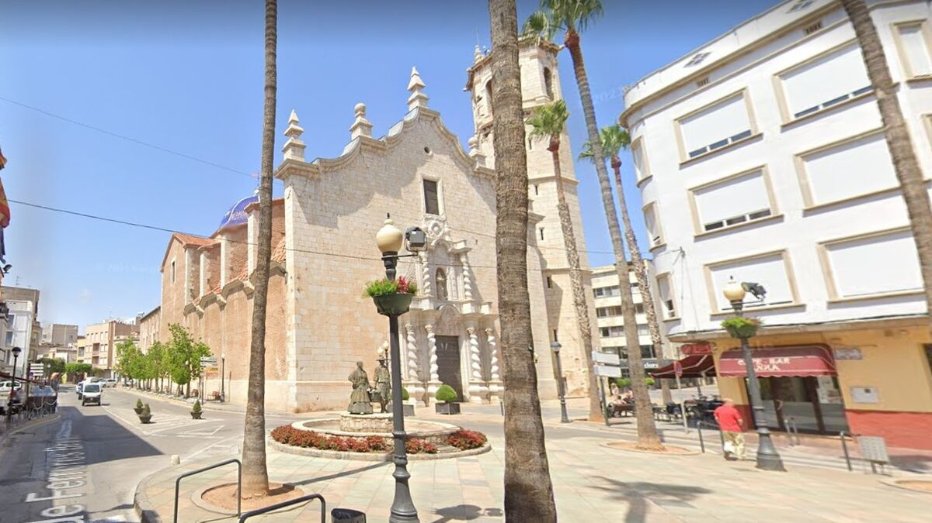
Benicarló has 28380 inhabitants

Slide 20
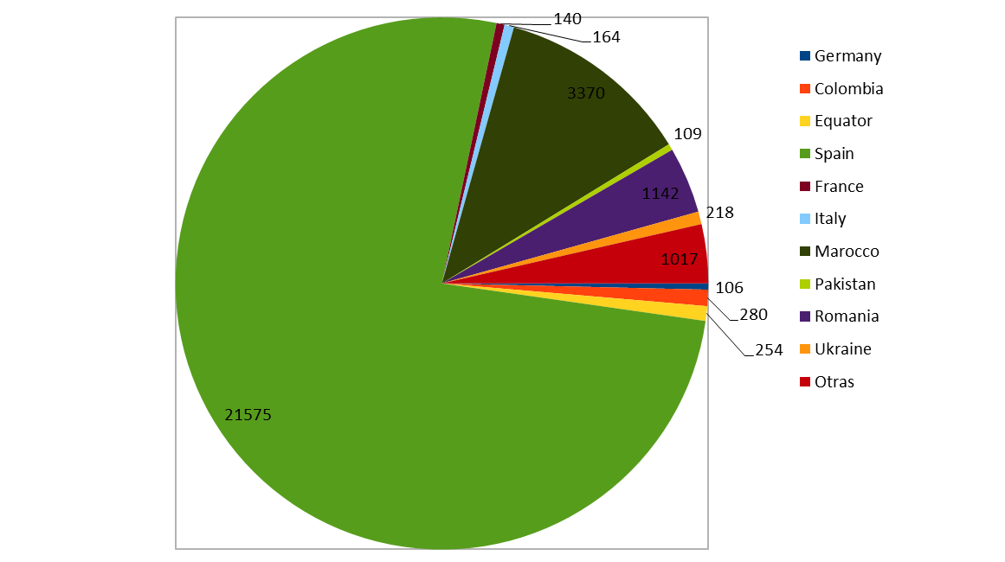

Slide 21
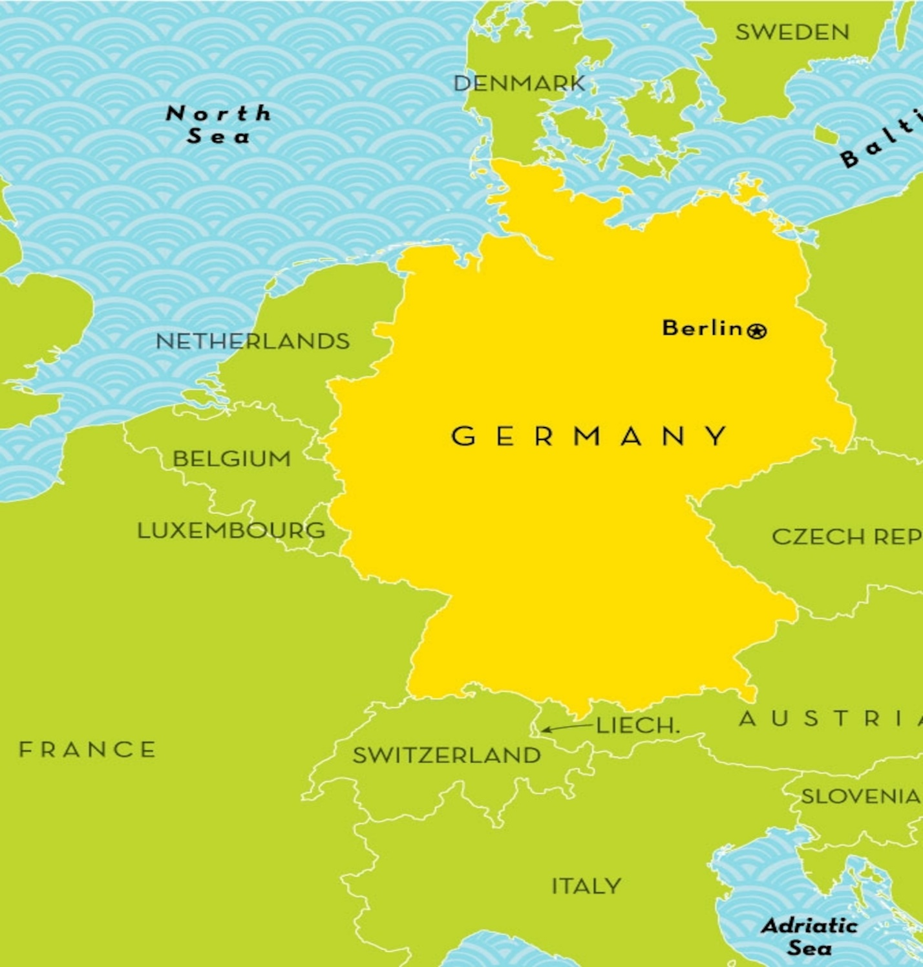
GERMAN PEOPLE
106 inhabitants

Slide 22
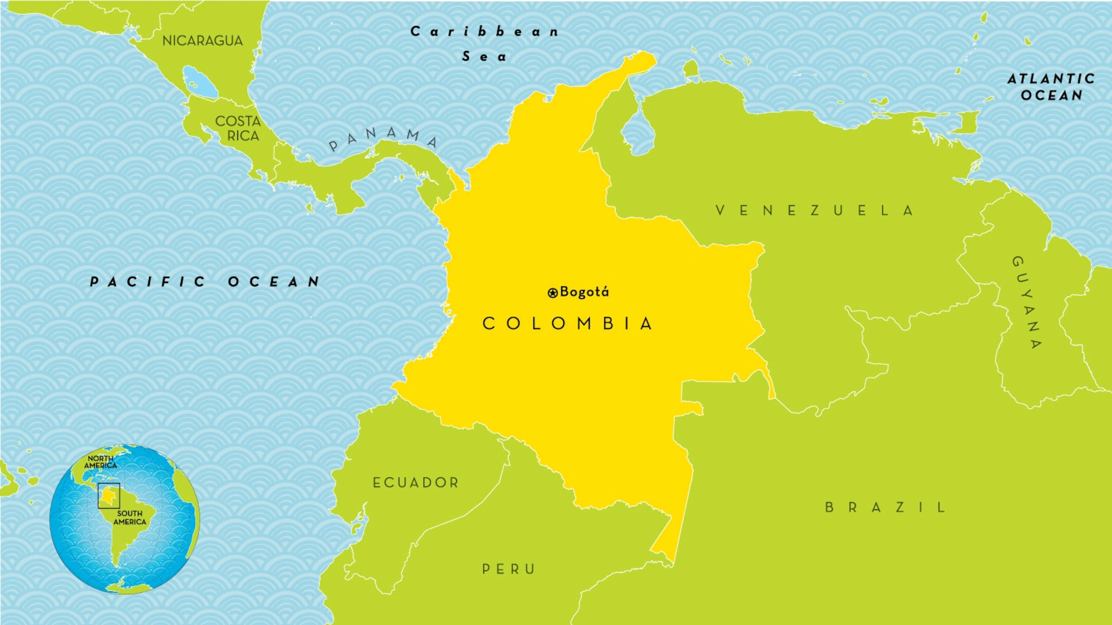
COLOMBIAN PEOPLE
285 inhabitants

Slide 23
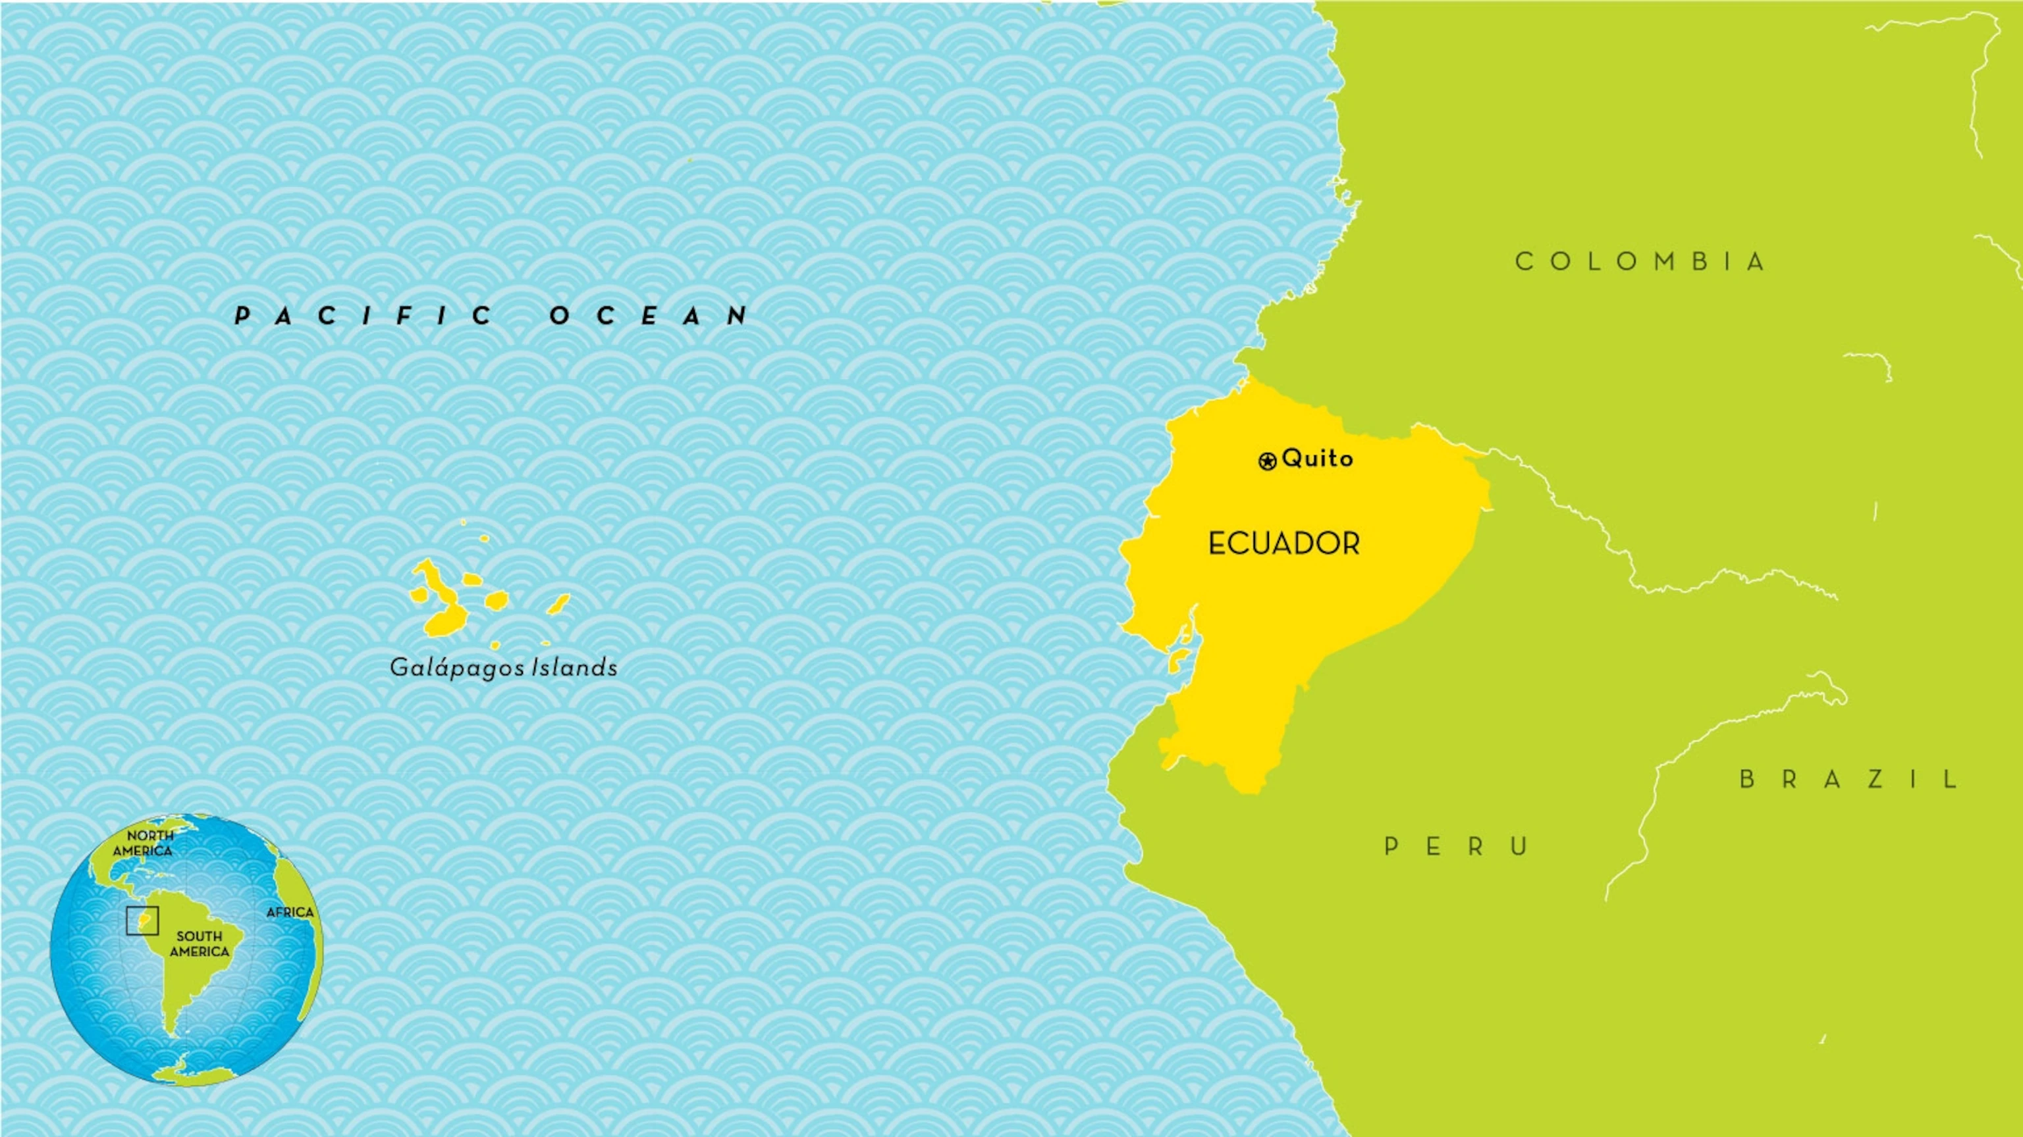
ECUADORIAN
PEOPLE
254 inhabitants

Slide 24
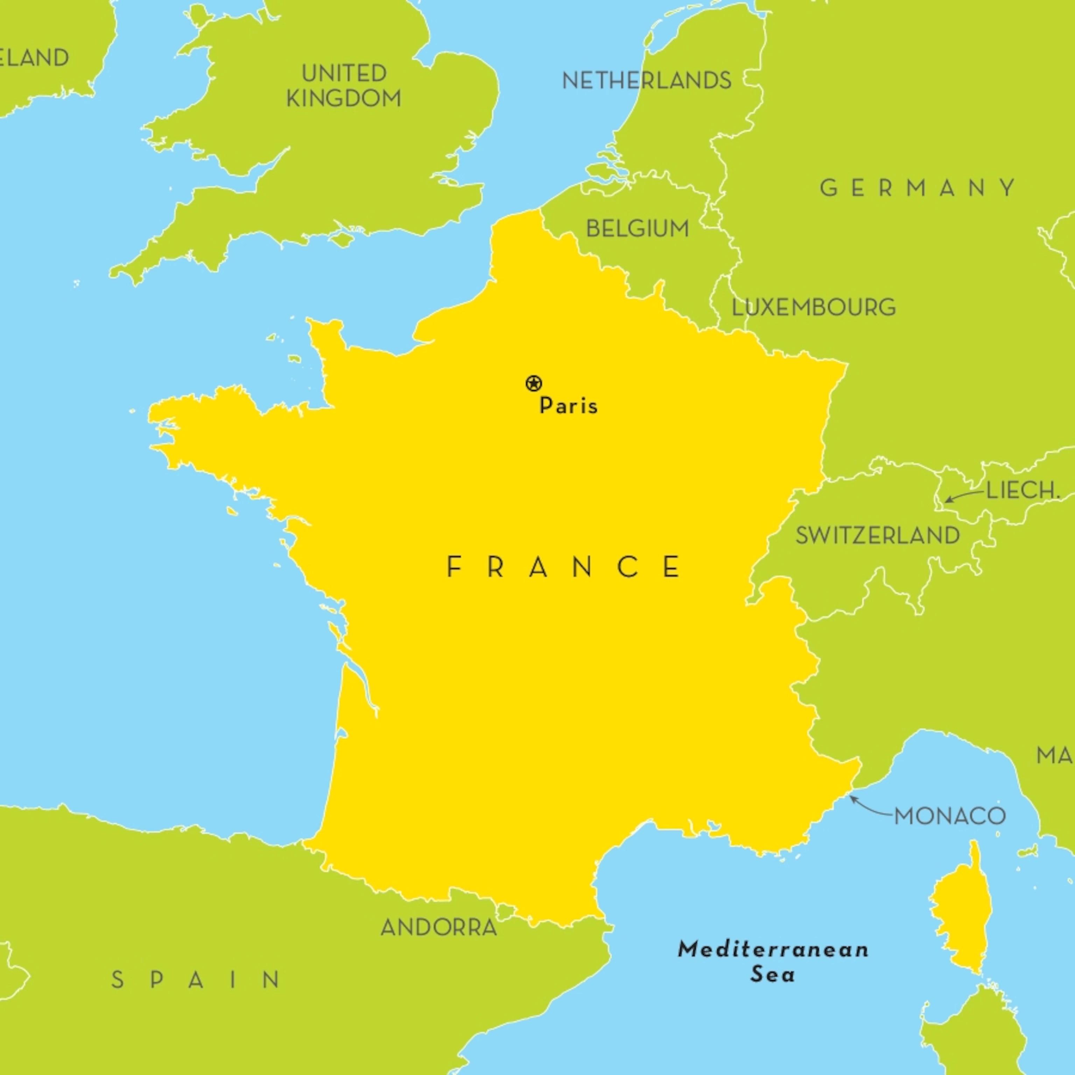
FRENCH PEOPLE
140 inhabitants

Slide 25
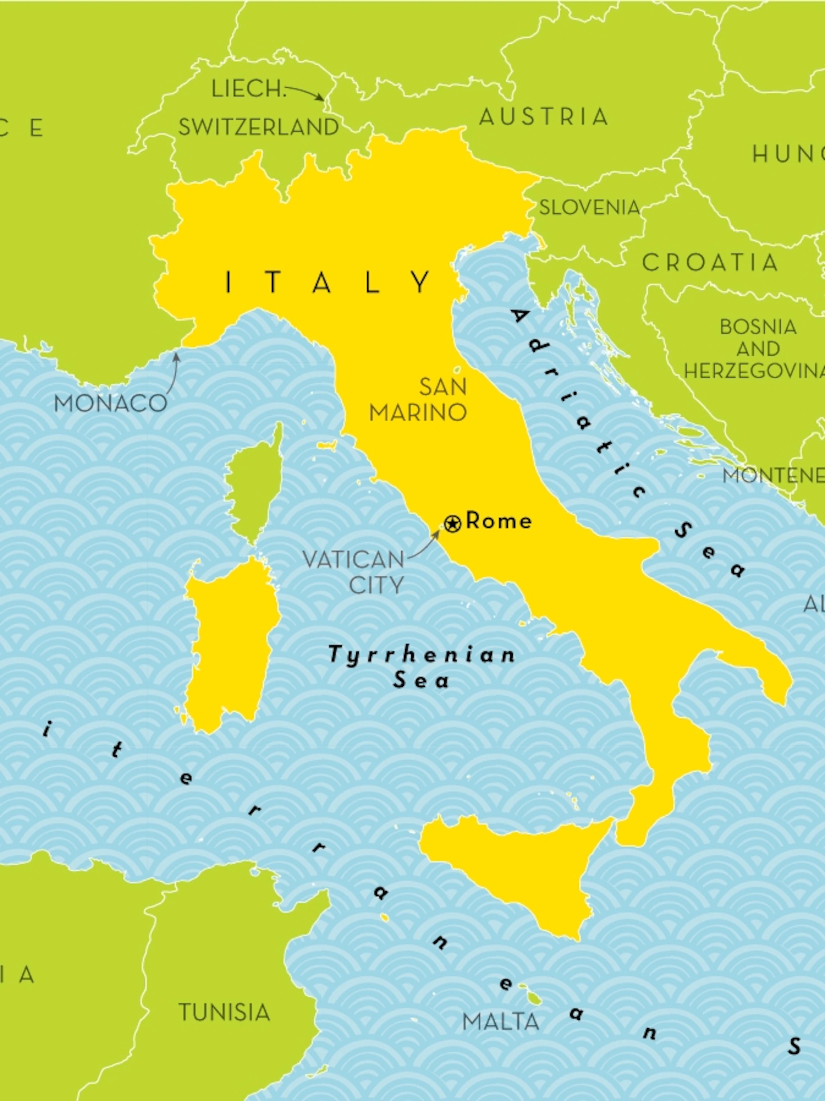
ITALIAN PEOPLE
164 inhabitants

Slide 26
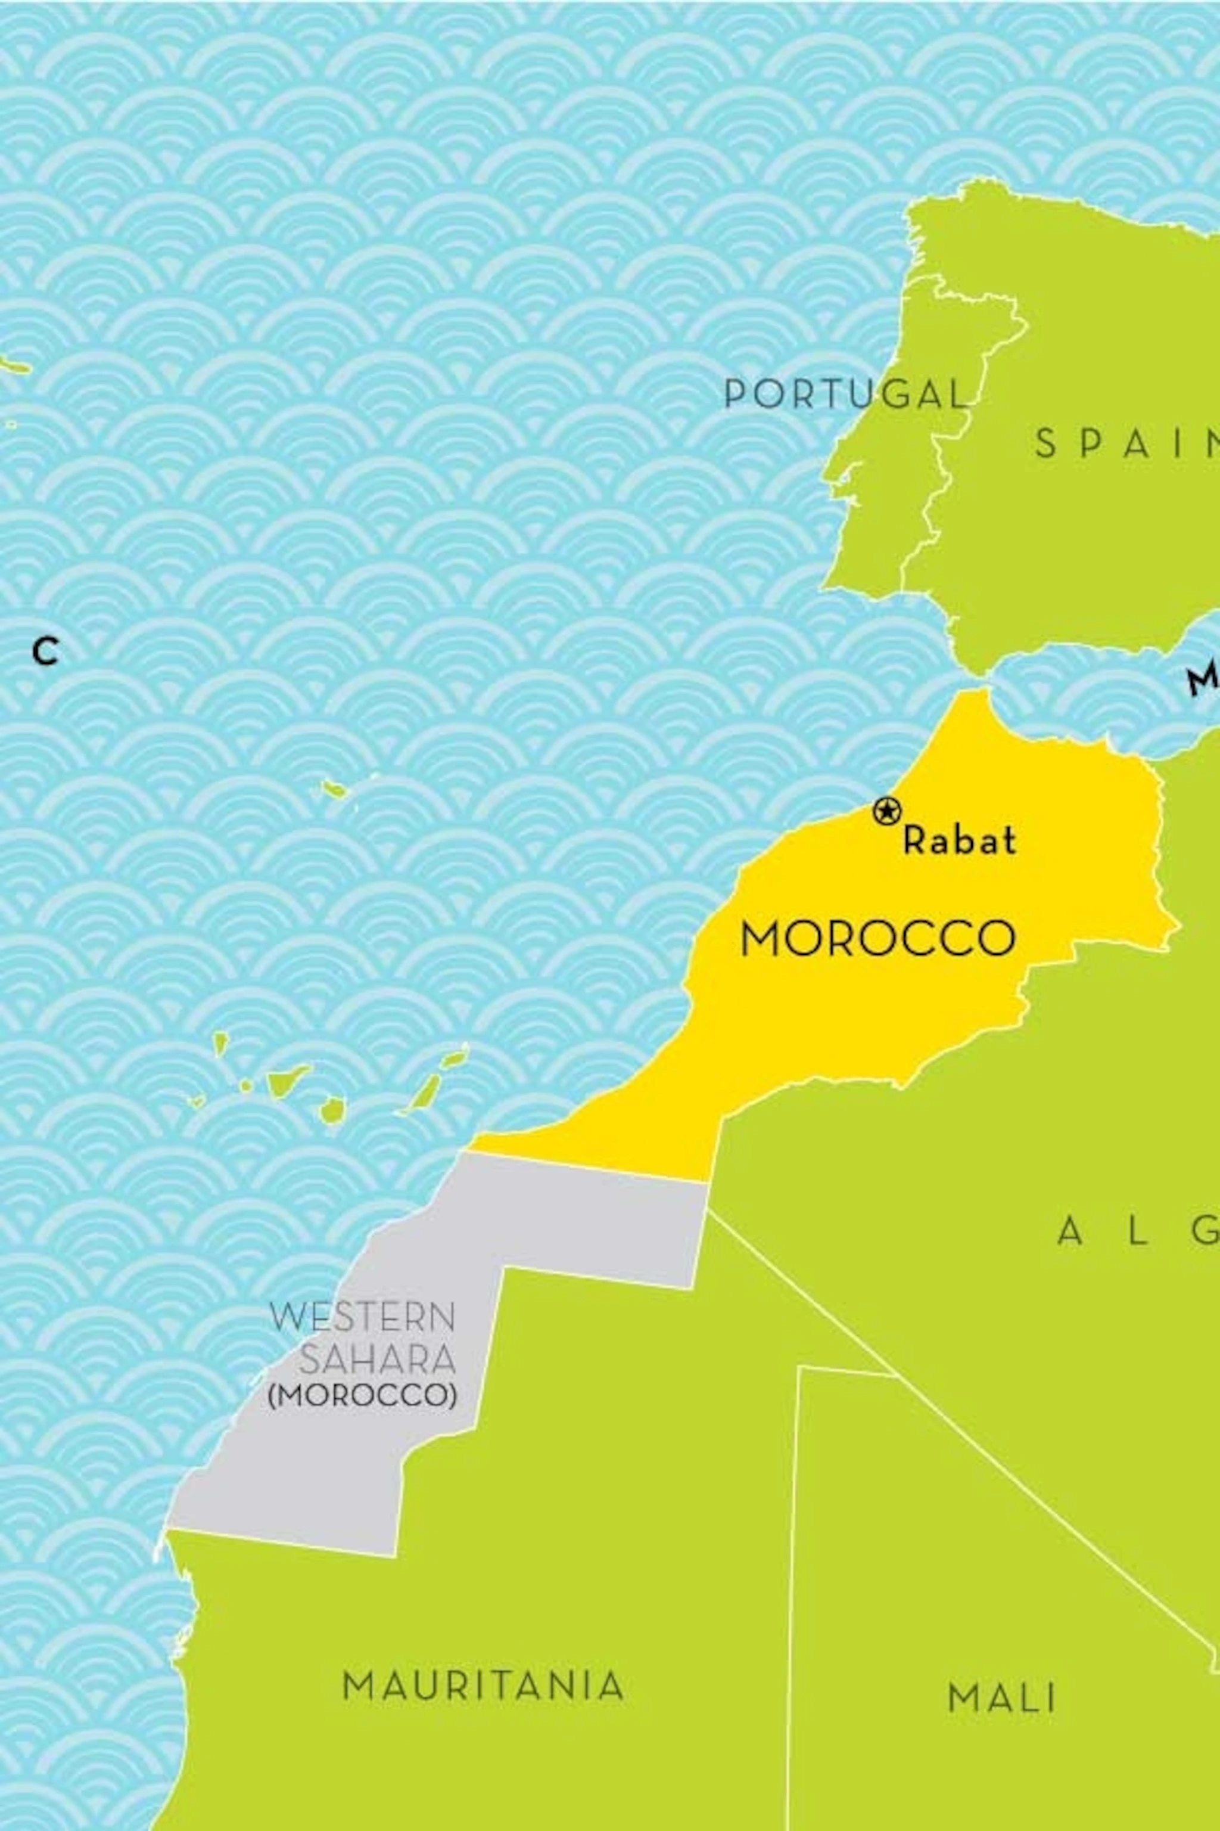
MOROCCAN PEOPLE
3370 inhabitants

Slide 27
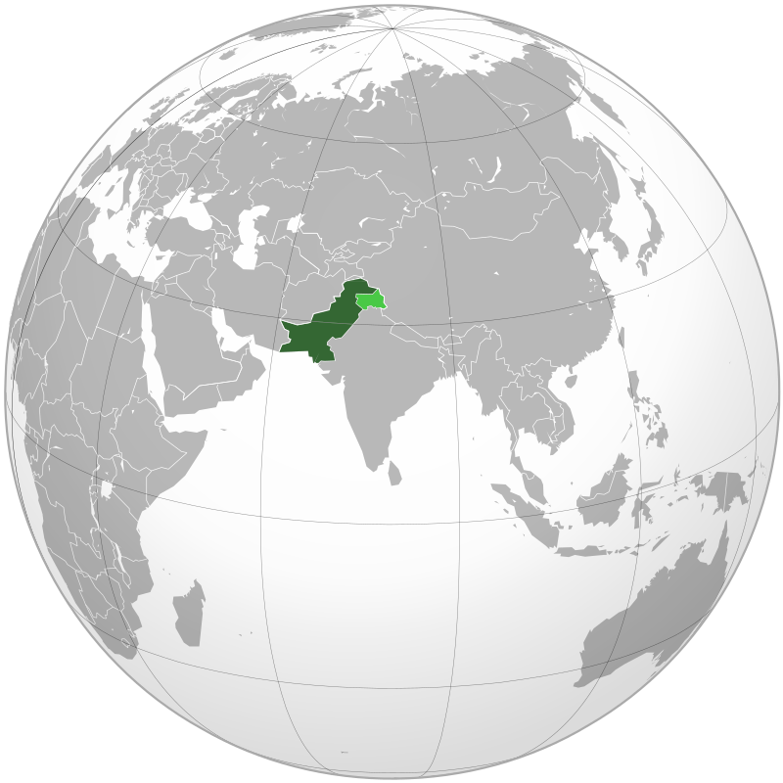
PAKISTAN PEOPLE
109 inhabitants

Slide 28
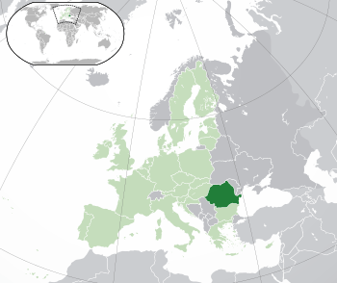
ROMANIAN PEOPLE
1142 inhabitants

Slide 29
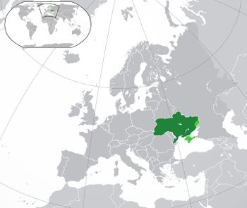
UKRAINIAN PEOPLE
218 inhabitants

Slide 30
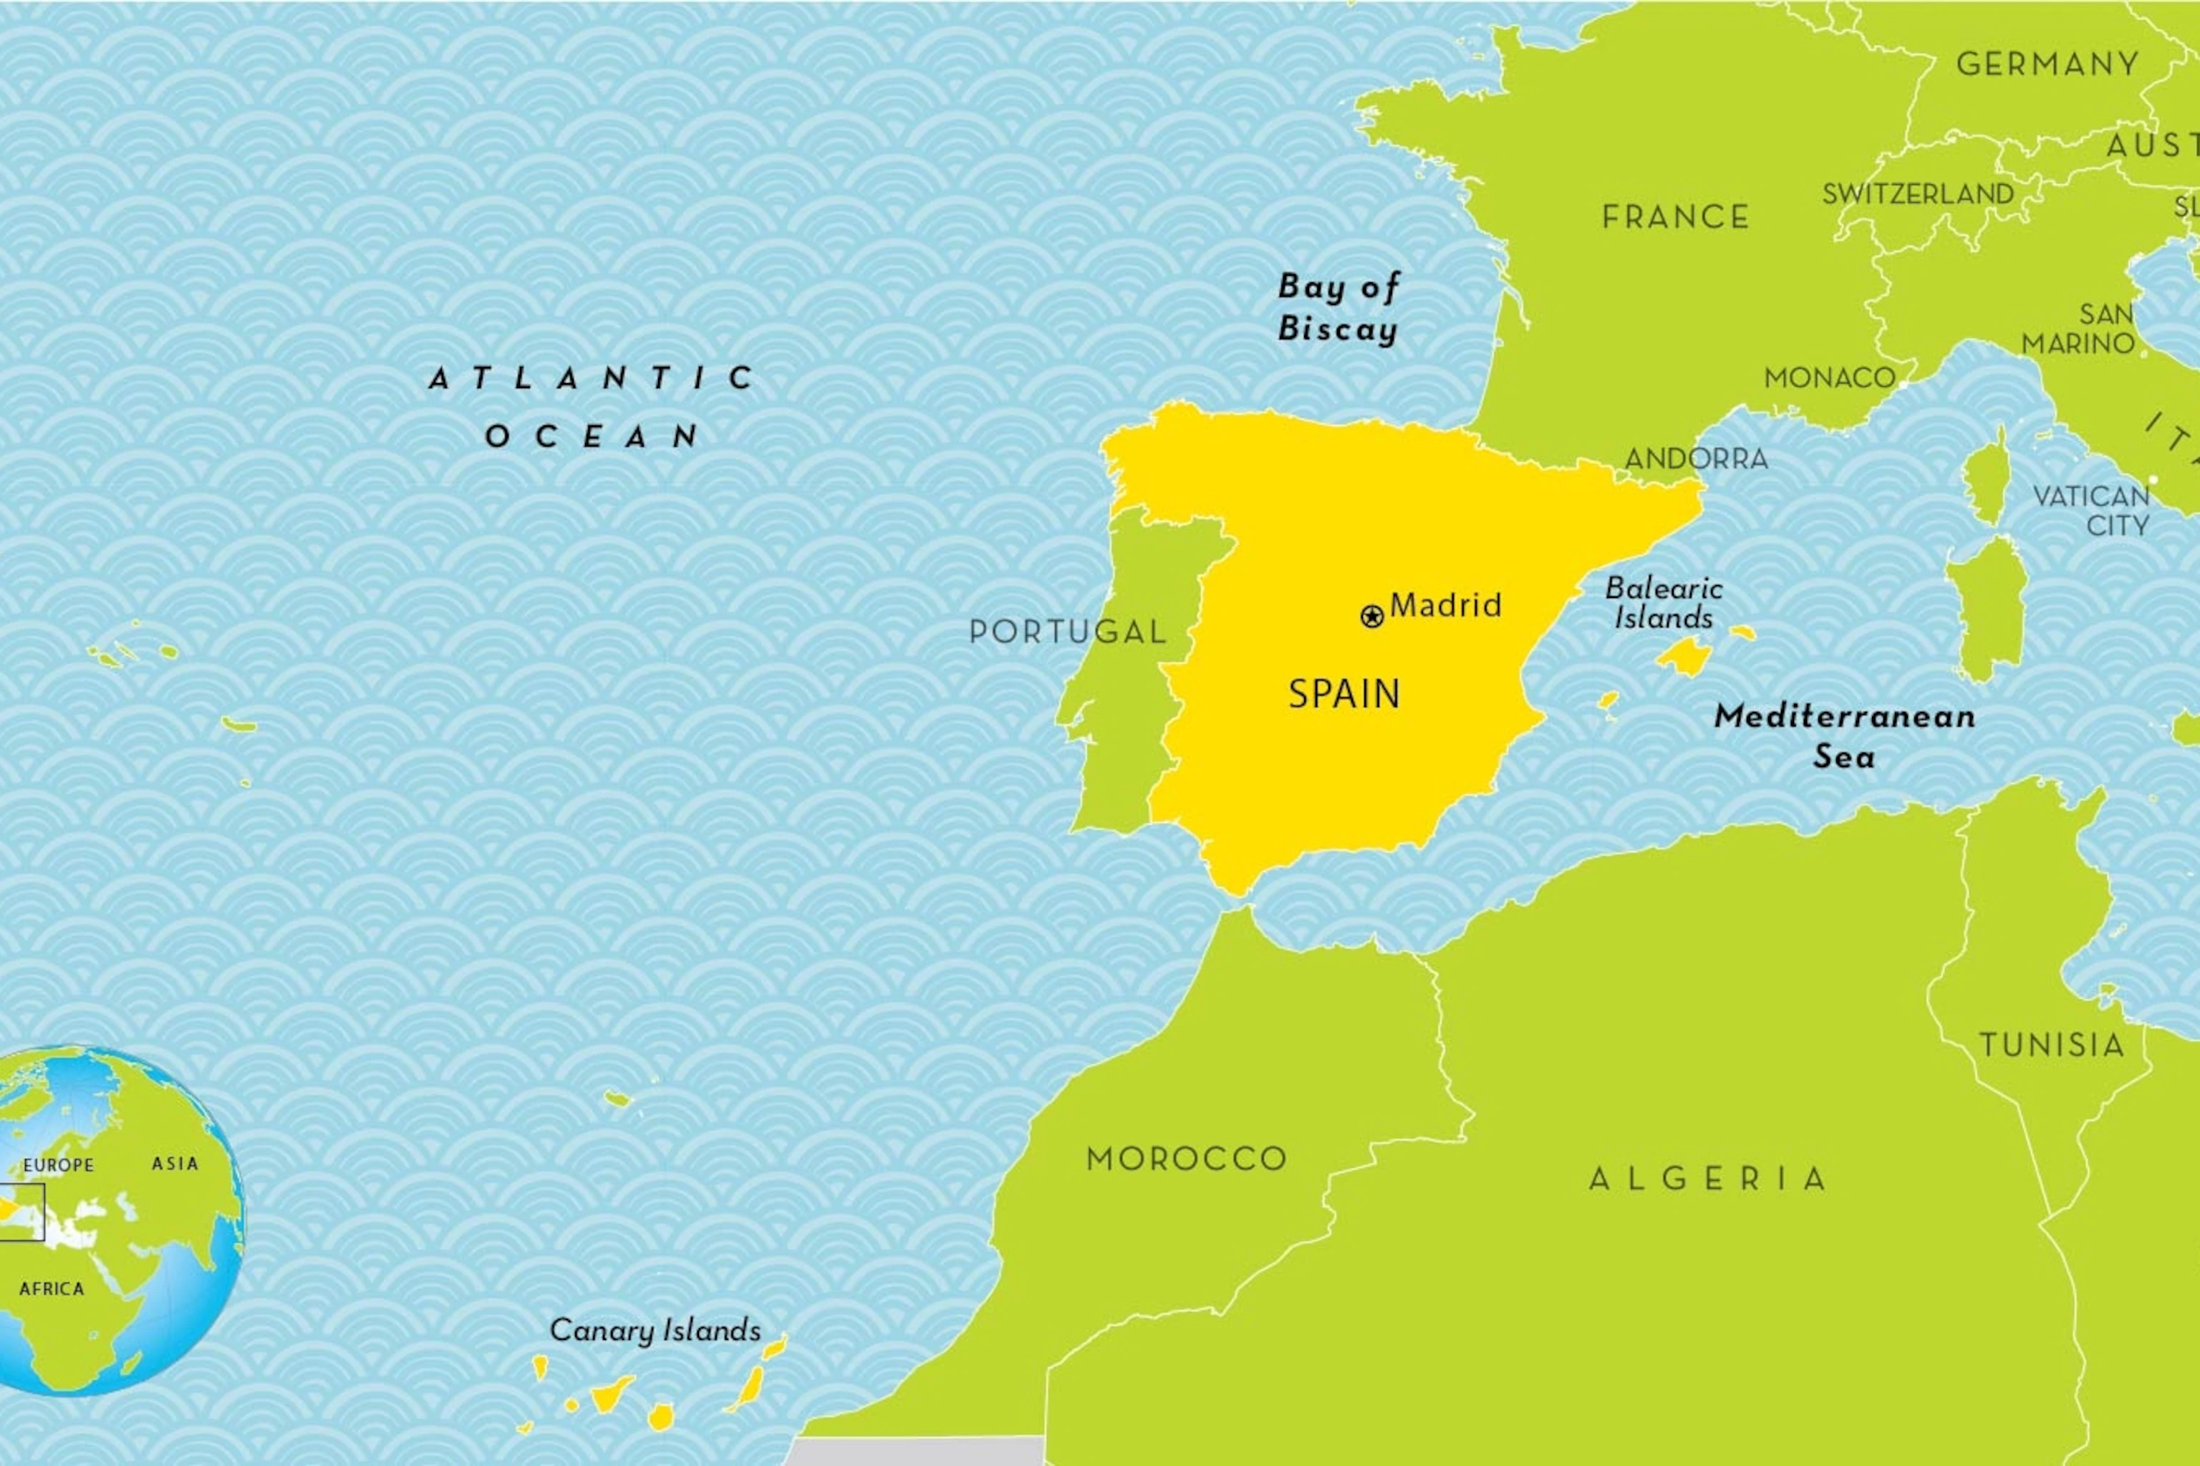
SPANISH PEOPLE
21575 inhabitants

Slide 31
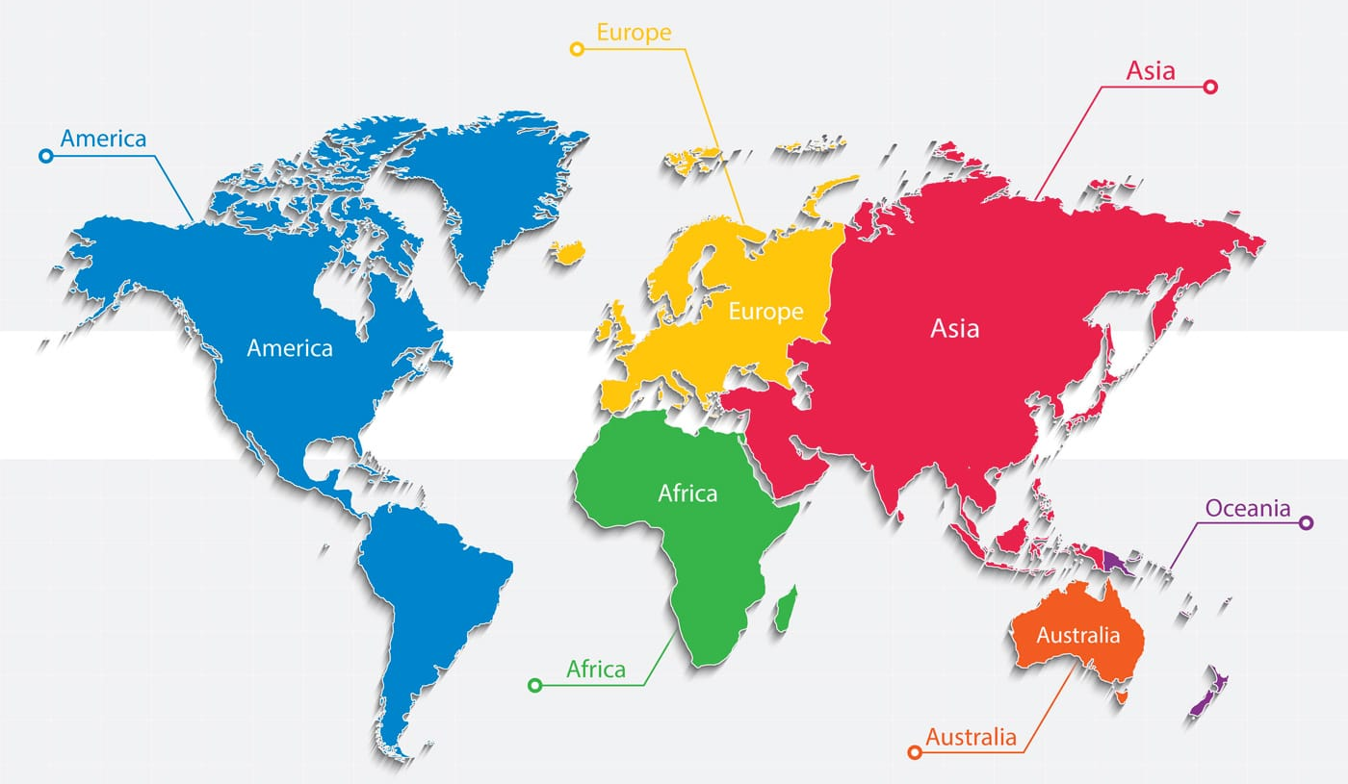
OTHER NATIONALITIES
1014
inhabitants

Slide 32
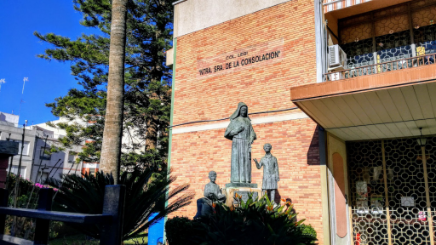
Our school has 749 pupils

Slide 34
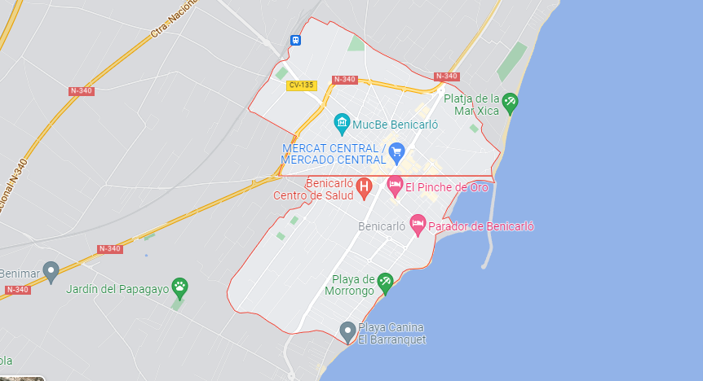
Benicarló
Vinaròs
Peñíscola

Slide 35
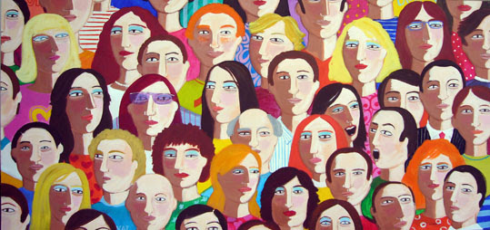
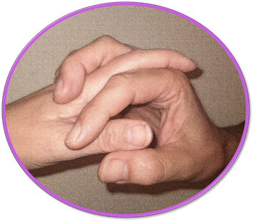
28.380 people
Boys: 14.186
Girls: 14.194
Photo and edition by: Ana

Slide 36
Sex | Number
Boys | 14.186
Girls | 14.194
Total | 28.380
Graphic by: Ana Roca

Slide 38
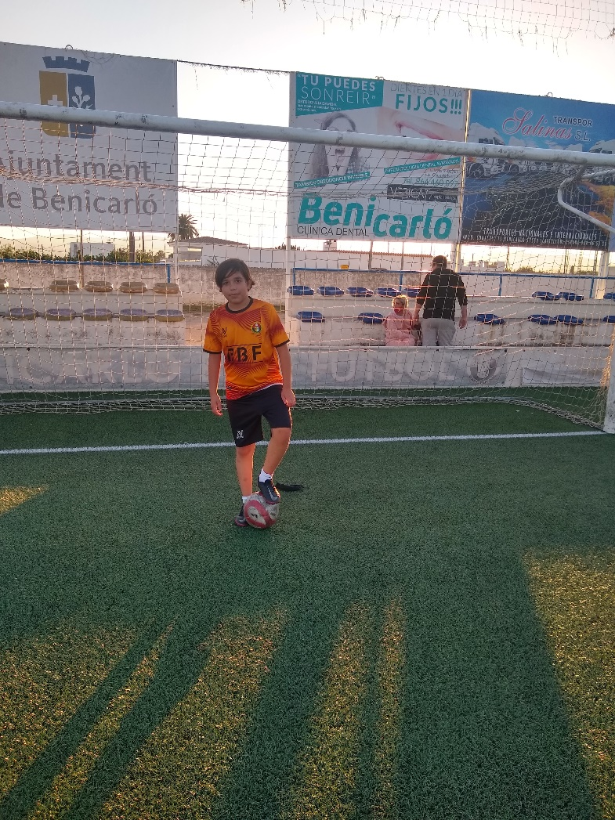
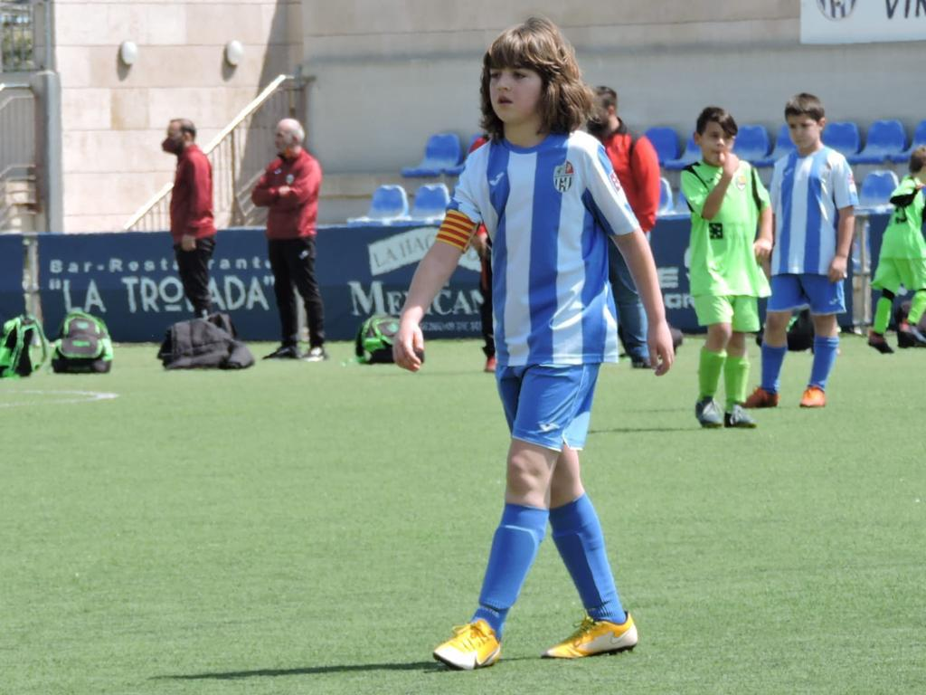
Football
Photos by; Itzan and Pau

Slide 39
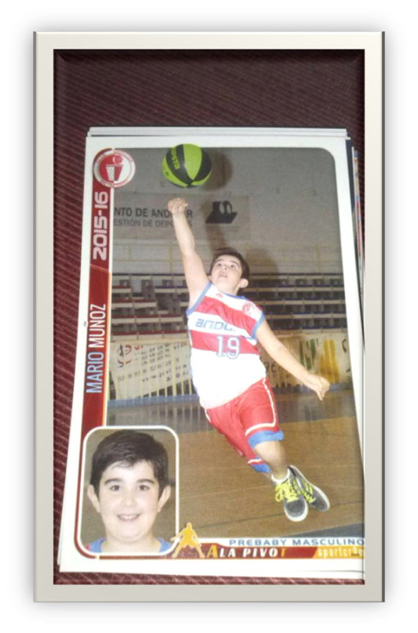
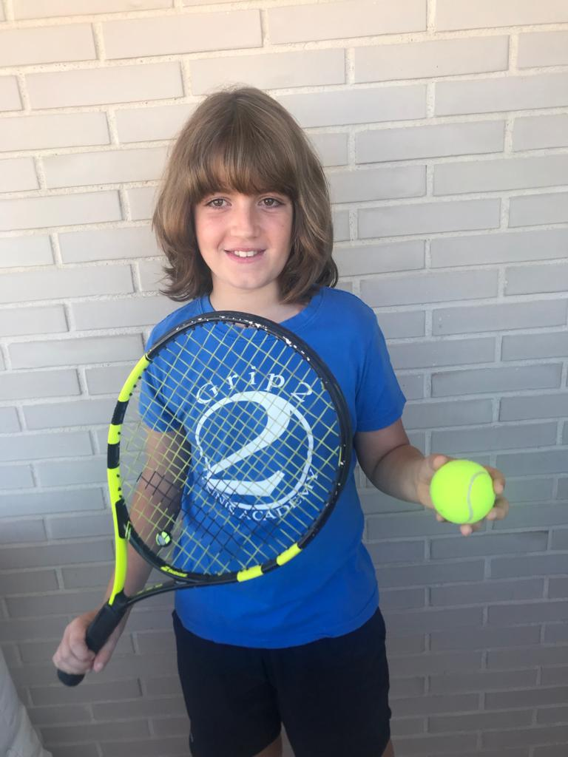
Tennis
Basketball

Slide 40
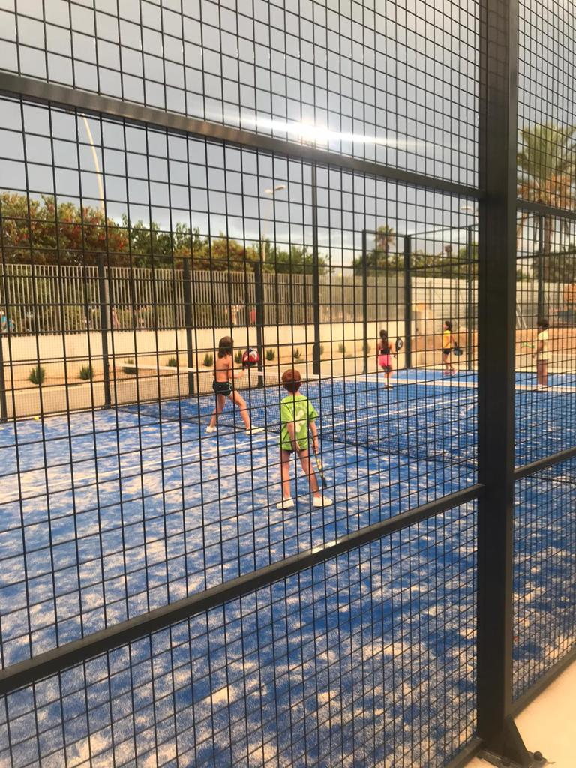
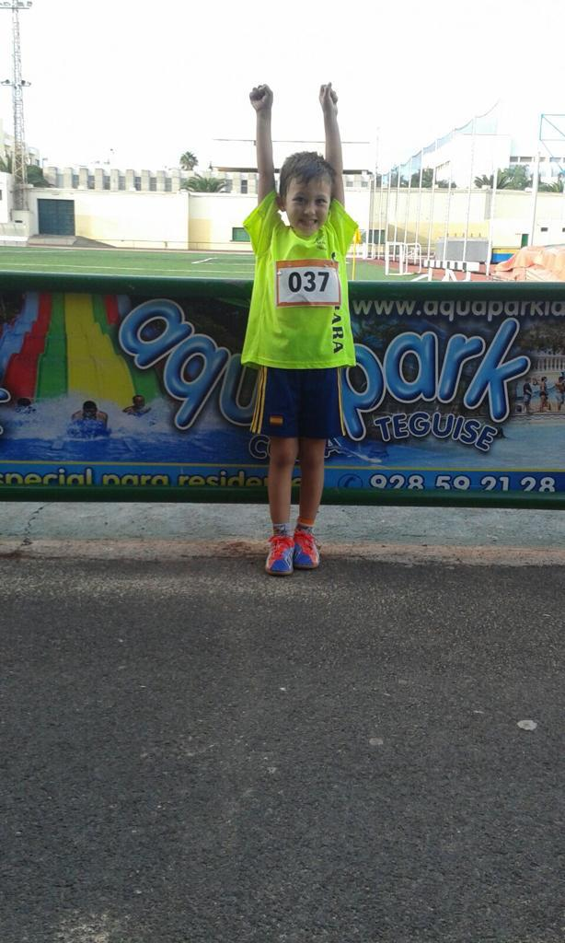
Athletics
Paddle

Slide 41
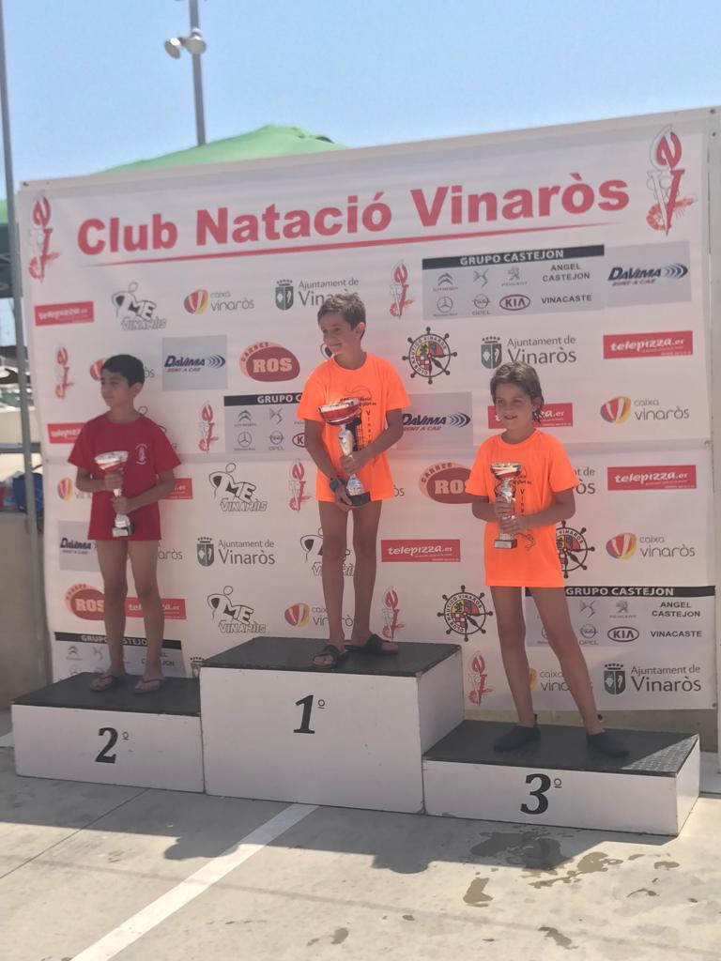
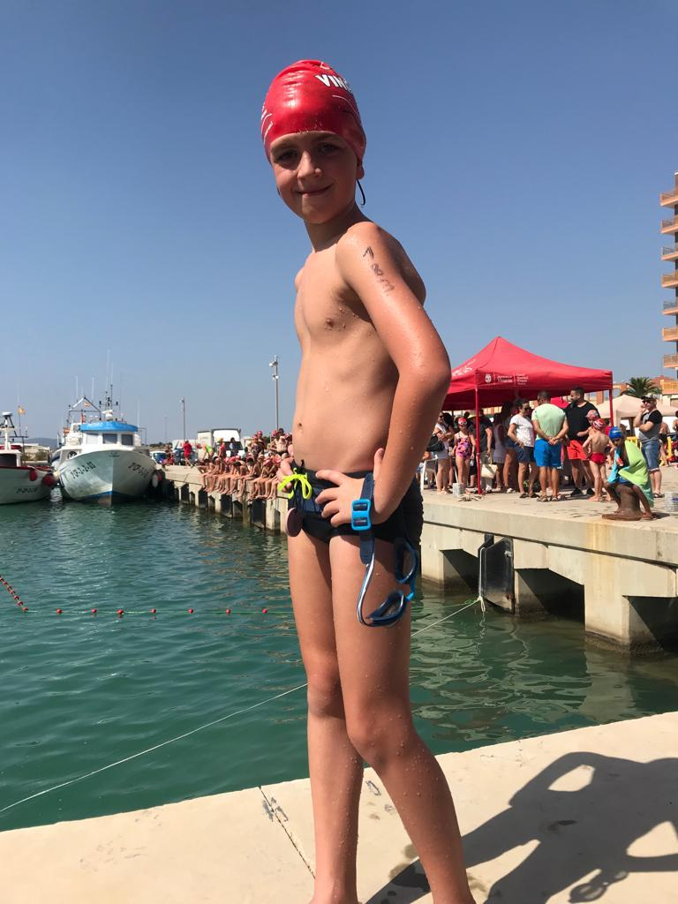
Swimming

Slide 42
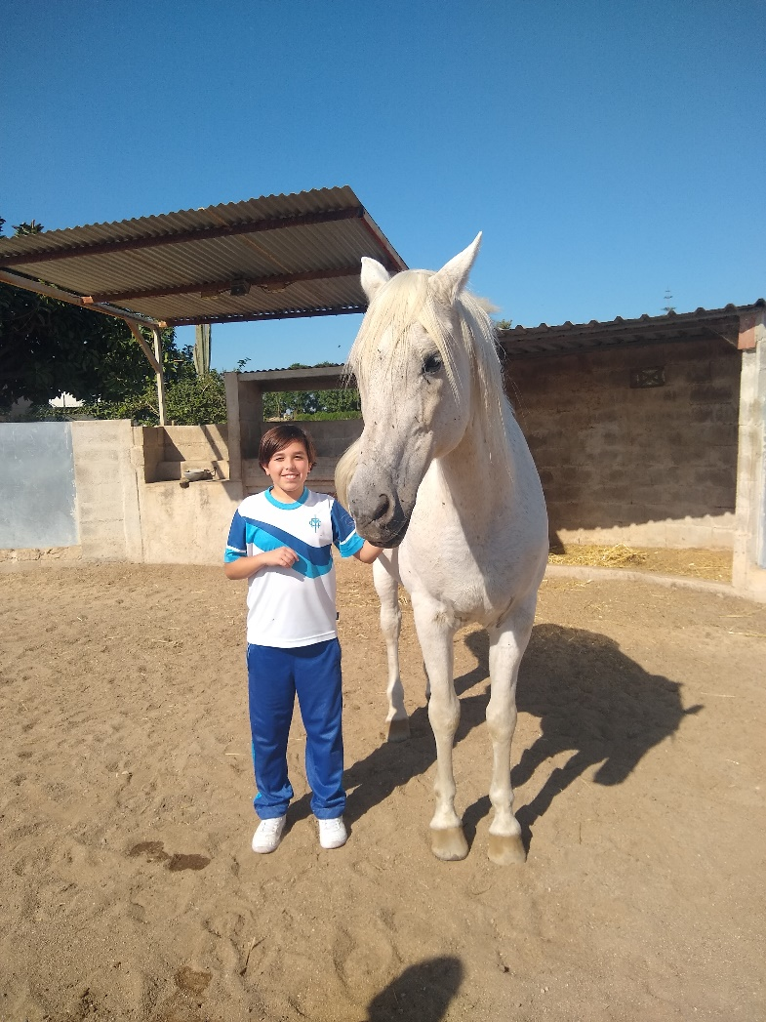
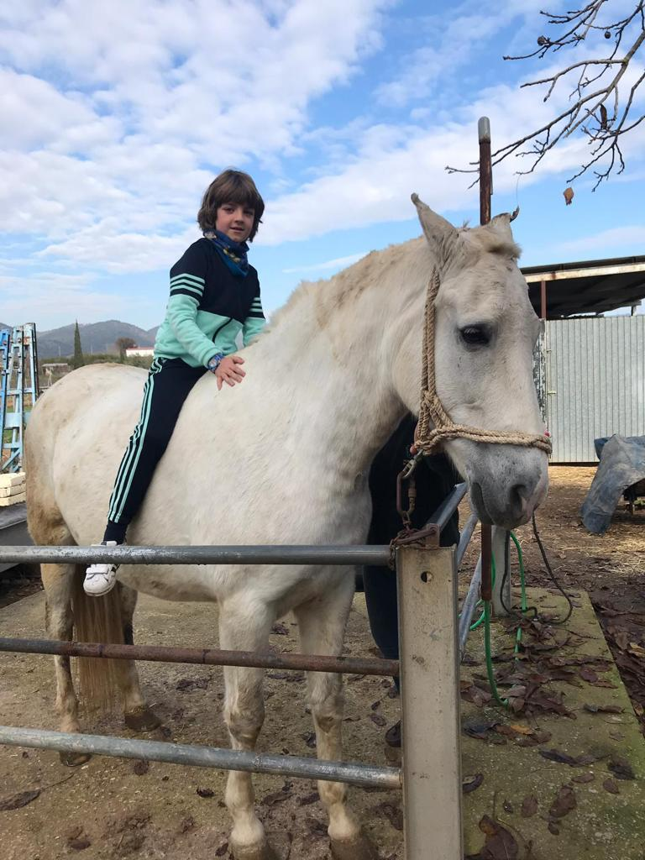
Equestrian

Slide 43
Gymnastics
Skating
Photos by: Fernanda, Leire and Camelia

Slide 44
FOOTBALL | 20
BASKETBALL | 16
TENNIS | 6
PADDLE | 5
GYMNASTICS | 2
SKATING | 5
SWIMMING | 6
EQUESTRIAN | 3
ATHLETICS | 11
OTHERS… | 8
By Fernanda, Leire and Camelia

